Slide 1



Social Buzz

Slide 2


Today's agenda
Project recap
Problem
The Analytics team
Process
Insights
Summary

Slide 3


Social Buzz, a rapidly growing technology unicorn, needs to adapt swiftly to its expanding global scale. Accenture has initiated a three-month Proof of Concept (POC) focusing on the following tasks:
Project Recap
Conducting an audit of Social Buzz's big data operations.
Providing recommendations for a successful IPO.
Analyzing to identify the top five most popular content categories for Social Buzz.

Slide 4



Problem
Social Buzz generates over 100,000 posts per day, leading to 36,500,000 pieces of content annually, creating challenges in effectively utilizing the vast amount of data.
The goal is to identify the top 5 most popular content categories to better understand audience engagement.
To achieve this, the data needs to be cleaned by removing missing values, adjusting data types, and eliminating irrelevant columns before analysis.

Slide 5




Marcus Rompton
Senior Principle
The Analysis Team
John Rompton
Team Lead
Henry smith
Data Anlyst

Slide 6


Process
1
Data Understanding
2
Data Cleaning
3
Data Modelling
4
Data Analysis
5
Uncover Insights

Slide 7





The platform has a total of 16 unique categories.
The most popular category, "Animal," received the highest number of reactions
Additionally, May was the month with the most posts.

Slide 8
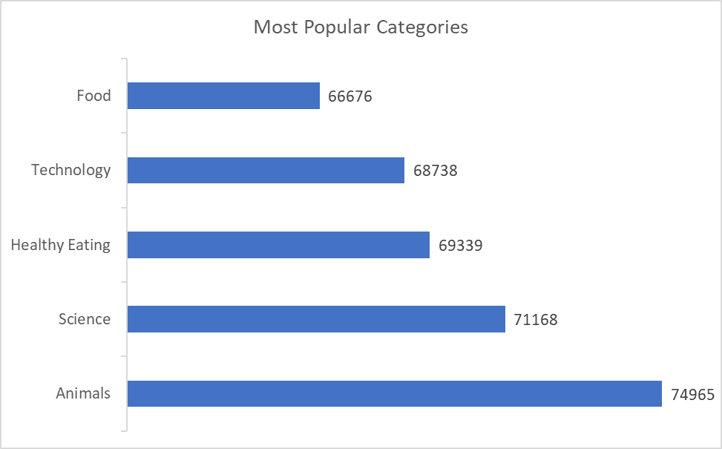
Most Popular Categories

Slide 9
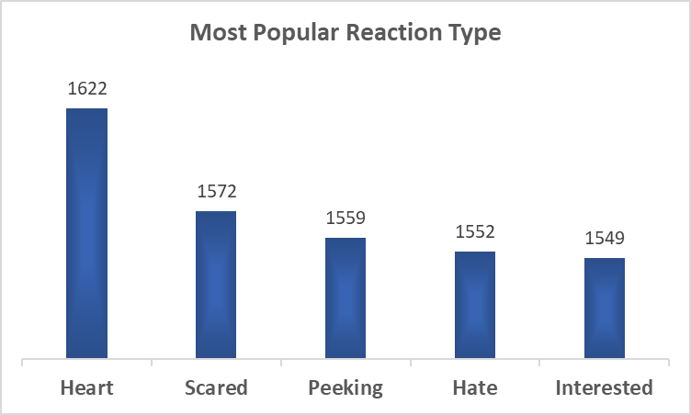

Slide 10
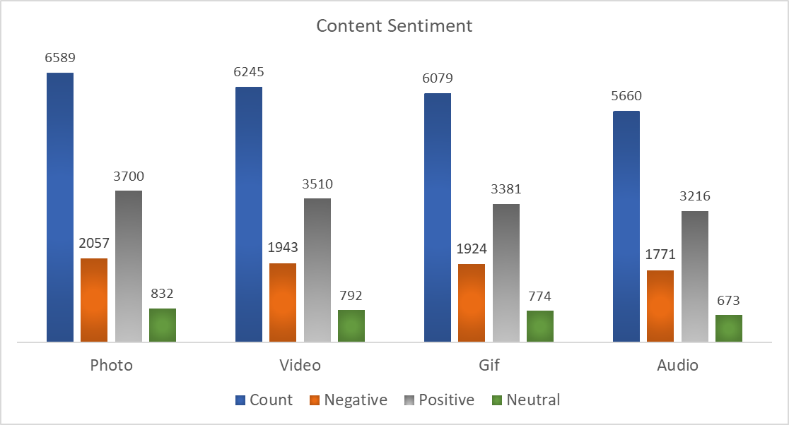
Content Sentiment

Slide 11

May is the top-performing month for content generation.
Animal content category is the most popular, attracting the highest engagement.
Heart reactions are the most common, indicating positive sentiment across reactions.
Photos are the most frequently shared content type, with Positive sentiment outweighing Negative sentiment.
Videos and GIFs are also highly shared, with Positive reactions leading, though Negative reactions are still significant.
Summary

Slide 12

Thank You!!
Any Question ??

